Slide 1

Diagnosis of Early Onset Influenza Using Machine Learning Classification
Supervised by : Dr. Ranjan Kumar
Prepared by : Raman (20059570019)
Rohan Bhalla(20059570041)
Bharat Sharma(20059570040)

Slide 2
Aim
The objective of this research project is to enhance the use of machine learning model for the accurate detection of influenza using clinical data and biomarkers. The model will be trained on large datasets of influenza cases to identify key indicators and patterns of the disease. The aim is to create a robust and reliable tool for early detection and diagnosis of influenza, which can improve patient outcomes and inform public health interventions.
Additionally, the research will investigate the potential of the machine learning model to predict the severity of influenza and identify patients at higher risk of developing complications. Ultimately, the project aims to contribute to the development of effective strategies for influenza management and control.

Slide 3
Abstract
Influenza is a contagious respiratory illness that causes significant morbidity and mortality worldwide. Early detection and diagnosis of influenza are crucial for effective management and control of the disease. In this research project, we use various machine learning model for the detection of influenza using clinical data and biomarkers. The model was trained on large datasets of influenza cases to identify key indicators and patterns of the disease. Our results demonstrated that the machine learning model achieved high accuracy in detecting influenza, outperforming traditional diagnostic methods. Additionally, the model showed potential for predicting the severity of influenza and identifying patients at higher risk of developing complications. These findings suggest that the machine learning model has the potential to improve patient outcomes and inform public health interventions for influenza. Our research contributes to the development of effective strategies for influenza management and control and highlights the potential of machine learning in healthcare.

Slide 4
Introduction
Machine learning is a rapidly evolving field that has shown promising results in healthcare, including disease detection and diagnosis. In recent years, machine learning has been applied to various aspects of influenza, such as predicting influenza outbreaks and identifying key viral mutations. However, the potential of machine learning in the accurate detection and diagnosis of influenza has not been full explored.
The greatest number of deaths inflicted on the human population by the virus is in the year 2016, when 3985 lives were lost, comprising almost equal Male (1987) and Female (1998) deaths.
The virus spreads as yearly outbreaks and in the past has affected at least 2 million people every outbreak and caused >200,000 deaths. Notable records of the virus exist such as “Spanish flu”, “Asian Influenza”, and” Hong-Kong Influenza”. This research project has significant implications for public health, as accurate and efficient diagnostic tools for influenza can aid in the timely identification and control of outbreaks. Furthermore, the potential of machine learning in healthcare can transform the way we diagnose and manage diseases, leading to improved patient outcomes and reduced healthcare costs.

Slide 5
So as to remain in compliance with researches already done by various authors and remain acknowledged with the latest trends in learning model techniques, we read through many articles, reports and papers published across various sites. Majority of them provided us information about the spread and manifestation of viruses and giving ways of preventing them through various practices. Information about learning environments, what tools and models we could use, how to use them, what's the best way of mining certain attributes was also provided in them. Given how much assumptions and theorems there are on this subject matter, a lot of inferences had to be made so that no wrong information impedes our project, regarding information about statistical analysis, pattern recognition, ensemble methods, ROC curve analysis and much more.
Literature Review

Slide 6
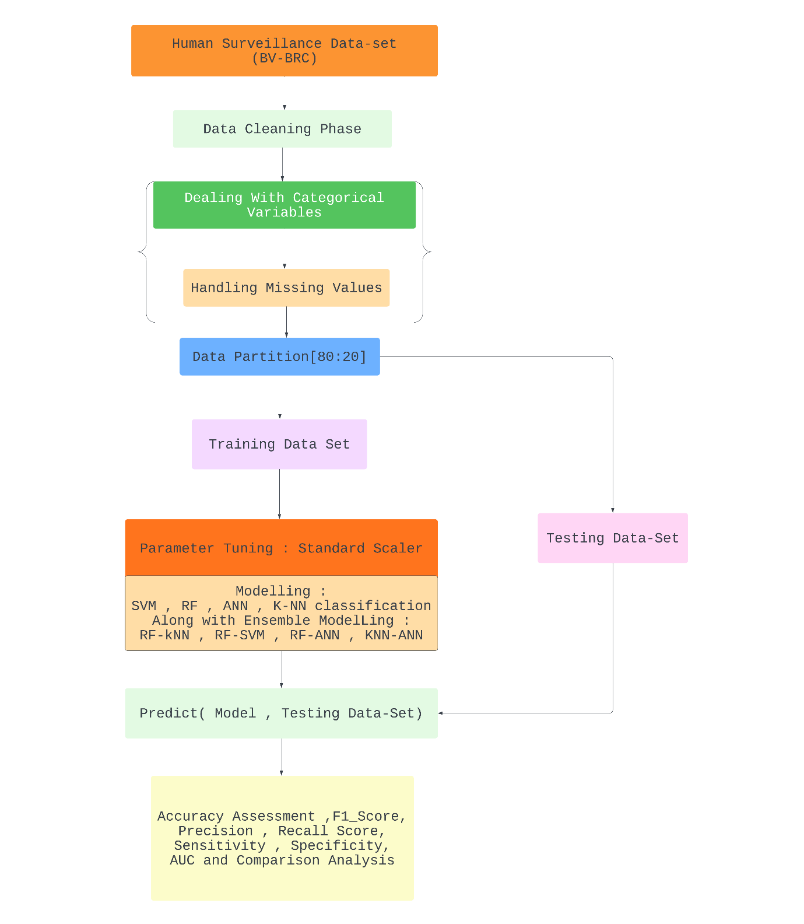
Methodology
The initial stage of the project involved pre-processing the data to ensure its accuracy and suitability for analysis. Once the data was pre-processed, we identified the symptoms and other clinical data as the main attributes for analysis.
To carry out predictive analysis on the pre-processed data, we implemented 4 different machine learning techniques and their Combinations, making the total Count of 9.

Slide 7
Dataset
We obtain the dataset from BV-BRC and it includes , research, information regarding the patient's collection year, age, and symptoms were studied and passed into the models which were then evaluated and concluded upon.
Aside from the type of pathogen a patient is infected with, the dataset also contains demographic information as well as the strain a patient is infected with. Patient's name, email address, and similar attributes were removed at the beginning because they are irrelevant to the purpose of the project.
This dataset contains appropriate variables and structure from the Bacterial and Viral Bioinformatics Resource Center. The data obtained for this project is limited to humans only, for practical and ethical reasons.

Slide 8
The data We get from BV-BRC contains 30531 rows and 96 columns. Most of the Columns are Empty i.e, Null . The “symptoms” column contained data points in the form of key-value pairs, which were then separated into rows and columns, respectively. Furthermore, all the Yes/No/Blank data points were converted into binary data, with Blank and No being considered as 0, and yes being considered as 1. The data points in the gender column were converted to binary data, with Males getting initialised as 0 and Females getting initialised as 1. Then, only rows having all instances filled were taken into consideration, the rest were removed. Any row or column value having its instance as null was removed and disregarded After having finalised the data pre-processing, 18582 rows and 23 columns remain, which only contain a patient’s fully-procured relevant data with the collection year, symptoms, gender and age, all columns necessary for processing. The data was divided into sets of 70% or 80% training and rest for testing, to be comprehended by the learning models.
Data Pre-Processing

Slide 9
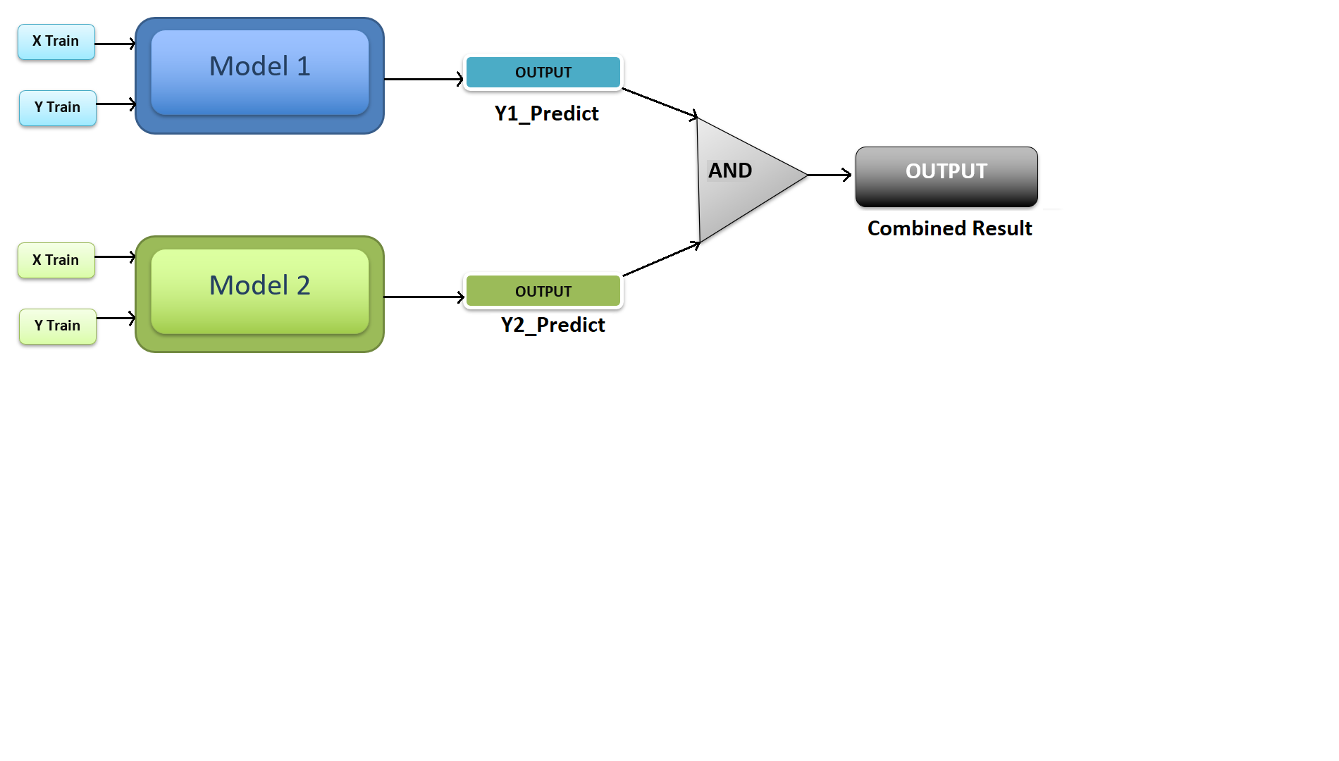
Combination of 2 ML Models

Slide 10
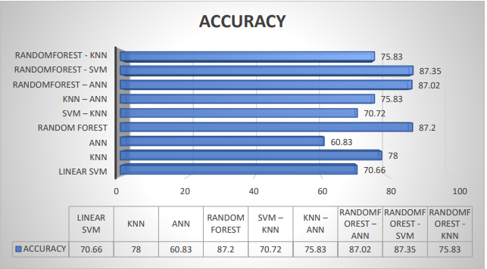
Result Analysis
Accuracy Graph of Different Machine Learning Techniques(graph)

Slide 11
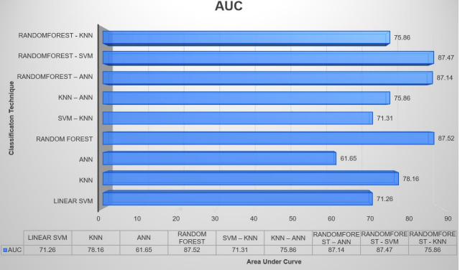
Result Analysis
AUC Graph of Different Machine Learning Techniques(graph)

Slide 12
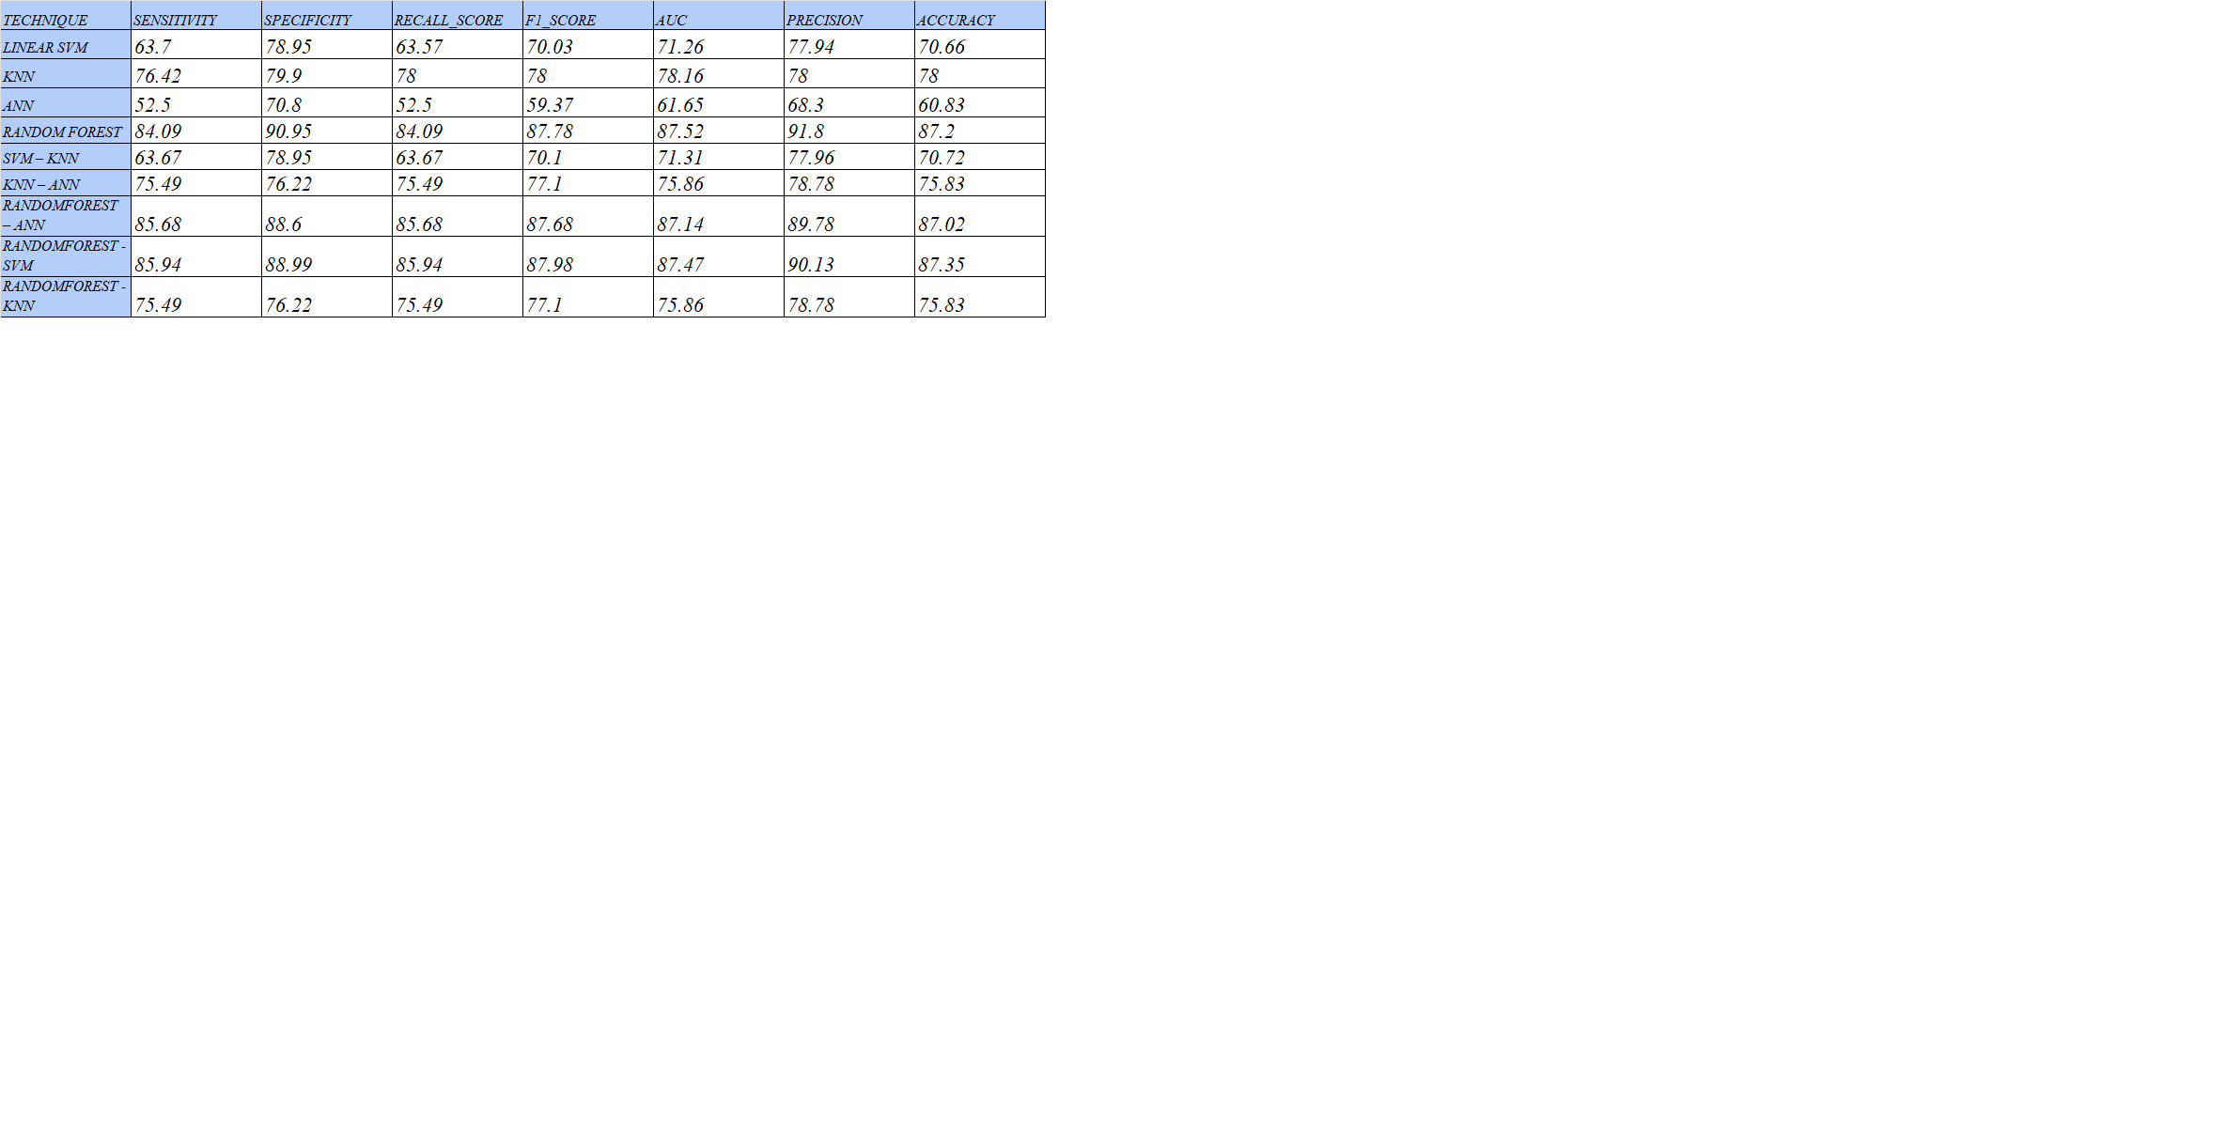
Result Analysis
Performance Measures for Different Machine Learning Techniques(table)

Slide 13
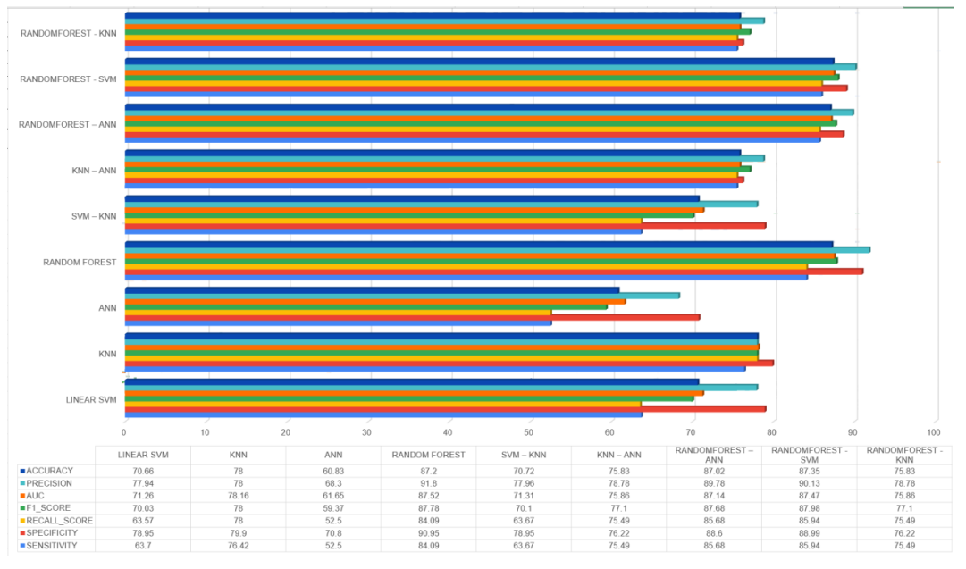
Result Analysis
Performance Measures for different Machine Learning (graph)

Slide 14
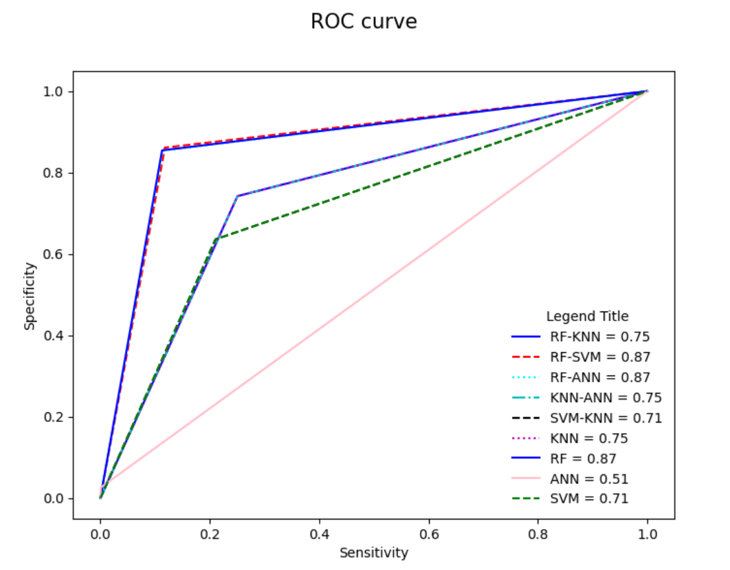
Result Analysis
ROC curve of the Machine Learning Techniques(graph)

Slide 15
Conclusion
Conclusion 1
Combined perform highly better than their singular counterparts. models
Conclusion 2
The ANN algorithm is not suitable for such labelled and varied data given its inaccuracy and metrical scores.
Conclusion 3
The Random Forest algorithm works very well with such a large amount of data and produces high scores and accuracy, irrespective of how its implemented.

Slide 16
Questions?
Any

Slide 17

Future Scope
For future practices to surpass us, the processes for data mining should be improved and used in such a manner that processed data is understandable to humans as well as the model, without much use of binary and/or arithmetic values
Models could be programmed in such a way that they adapt quickly to newly comprehended data, without deviating too much from the desired results even if the data consists of some minor looked-over impurities

Slide 18
References
Early Detection of Influenza using machine learning techniques by Sajal Maheshwari, Anushka Sharma, Ranjan Kumar and Pratyush.
Spreeuwenberg P, Kroneman M, Paget J. Reassessing the Global Mortality Burden of the 1918 Influenza Pandemic. Am J Epidemiol. 2018 Dec 1;187(12):2561-2567. doi: 10.1093/aje/kwy191. PMID: 30202996; PMCID: PMC7314216.
W. Paul Glezen, Emerging Infections: Pandemic Influenza, Epidemiologic Reviews, Volume 18, Issue 1, 1996, Pages 64–76, https://doi.org/10.1093/oxfordjournals.epirev.a017917
J. S. Malik Peiris, Menno D. de Jong, Yi Guan.: Avian Influenza Virus (H5N1): a Threat to Human Health. Clinical Microbiology Reviews 20 (2), 243-267, (2007). DOI: 10.1128/CMR.00037-06
Sullivan SJ, Jacobson RM, Dowdle WR, Poland GA. 2009 H1N1 influenza. Mayo Clin Proc. 2010 Jan;85(1):64-76. doi: 10.4065/mcp.2009.0588. Epub 2009 Dec 10. PMID: 20007905; PMCID: PMC2800287.
Grohskopf LA, Alyanak E, Ferdinands JM, et al. Prevention and Control of Seasonal Influenza with Vaccines: Recommendations of the Advisory Committee on Immunization Practices, United States, 2021–22 Influenza Season. MMWR Recomm Rep 2021;70(No. RR-5):1–28. DOI: http://dx.doi.org/10.15585/mmwr.rr7005a1.
Breiman, L. Random Forests. Machine Learning 45, 5–32 (2001). https://doi.org/10.1023/A:1010933404324
Venables, W.N. and Ripley, B.D. (2002) Modern Applied Statistics with S. Springer, New York, 271-300.https://doi.org/10.1007/978-0-387-21706-2
Ripley, B.D. (1996) Pattern Recognition and Neural Networks. Cambridge University Press, Cambridge. https://doi.org/10.1017/CBO9780511812651
JOUR Veloso, Bruno, Leal, Fátima, Gonzalez-Velez, Horacio, Malheiro, Benedita, Burguillo, Juan, 2018/06/01, Scalable data analytics using crowdsourced repositories and streams, 122, 10.1016/j.jpdc.2018.06.013, Journal of Parallel and Distributed Computing.
Arturo López Pineda, Ye Ye, Shyam Visweswaran, Gregory F. Cooper, Michael M. Wagner, Fuchiang (Rich) Tsui, Comparison of machine learning classifiers for influenza detection from emergency department free-text reports,,Journal of Biomedical Informatics, Volume 58, 2015, Pages 60-69, ISSN 1532-0464, https://doi.org/10.1016/j.jbi.2015.08.019. (https://www.sciencedirect.com/science/article/pii/S1532046415001872)
BOOK, Marquez, Edna, Barron, Valeria, 2019/11/01, 1, 5, Artificial Intelligence system to support the clinical decision for influenza, 10.1109/ROPEC48299.2019.9057056

Slide 19

Thanks!
Raman (20059570019)
Bharat Sharma (20059570040)
Rohan Bhalla (20059570041)
Department of Computer Science, Aryabhatta College, University of Delhi, New Delhi, Delhi 110021, India

